Slide 1
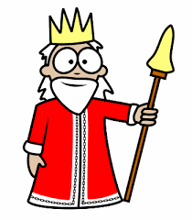
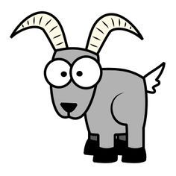
Carl Linnaeus' Classification System - Mnemonic
King
Phillip
Can
Often
Find
Goats
scary
Kingdom
Phylum
Class
Order
Family
Genus
species
Animals
Chordata
Mammals
Primates
Hominids
Homo
sapiens
(Ingest food, multi-cellular, no cell wall)
(Spinal cord)
(Nurse offspring)
(High intelligence)
(Walk upright)
(Human)
(modern human)

