Slide 1

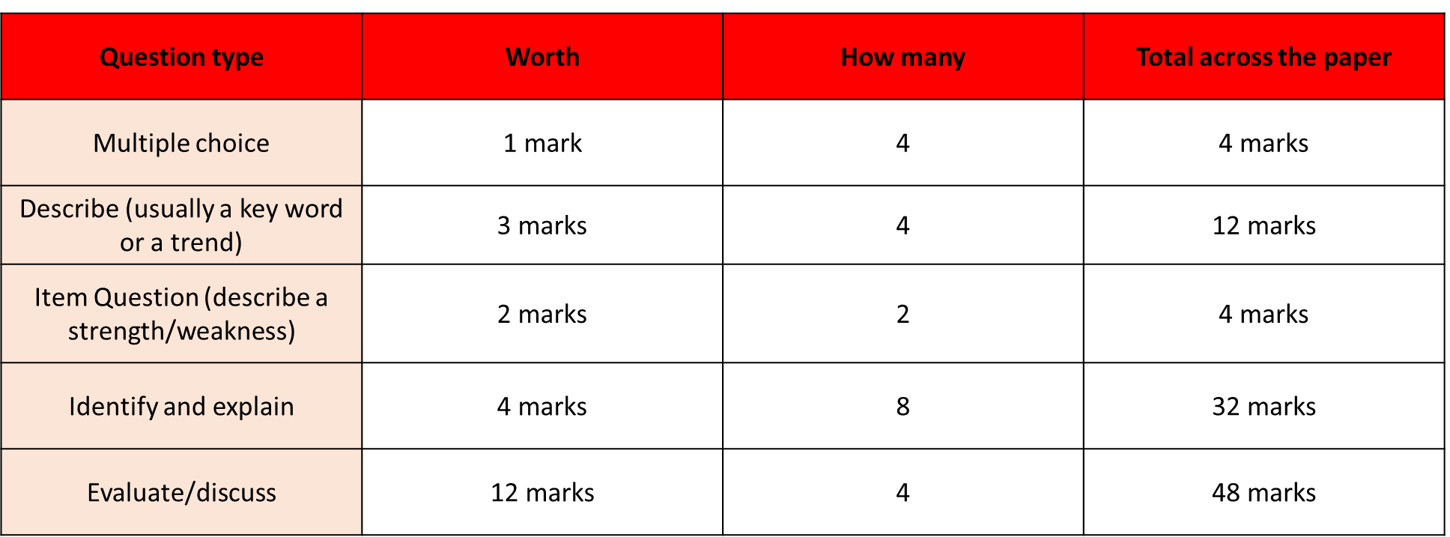
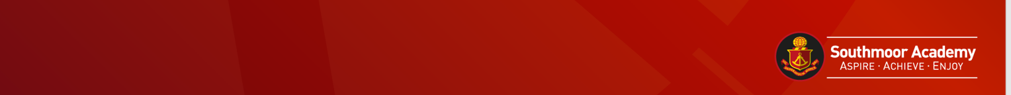
GCSE Sociology Revision: Paper 2
Crime Key Thinker
Merton – Functionalist
Becker – Interactionalist
Cohen – Functionalist
Carlen – Feminist
Heidensohn - Feminist
Stratification Key Thinker
Davis and Moore- Functionalist
Marx - Marxist
Weber
Townsend
Devine
Walby - Feminist
Murray - New Right

Slide 2
Key Words
Agenda setting | Crime rate | Identity theft | Media amplification | Scapegoat
Agent of social control | Criminal justice system | Indictable offence | Miscarriage of justice | Social stigma
Alienation | Dark figure of crime | Injustice | Moral panic | Surveillance
Anomie | Data protection | Institutional racism | News value | Subculture
Anti-social behaviour | Delinquency | Intelligence quotient | Official crime statistics | Technological change
Attitude survey | Deviancy amplification | Judiciary | Pluralism | Terrorism
Bias | Deviant career | Labelling | Popular press | Unwritten rules
Chivalry thesis | Discrimination | Law | Prison system | Urban
Community service | Ethnic diversity | Legislation | Racial discrimination | Value consensus
Conformity | Ethnic minority | Legislative process | Recorded crime | Victim survey
Content analysis | Ethnography | Magistrate | Reported crime | Welfare scrounger/benefit cheat
Control theory | Folk devils | Mass media | Right of appeal | White collar crime
Corporate crime | Gender deal | Master status | Role conflict | Youth crime

Slide 3
Crime 12 Mark Question Theme
Crime as a social construction | Becker – master status / deviant career Statistics Chivalry thesis Historical and cultural crimes Media and deviancy amplification
Trends | Class Gender Age Ethnicity
Main reason for crime | Merton – strain theory Cohen – subcultures / status frustration Inadequate socialisation
Methods of social control
Formal social control | Formal social control is based on written rules and laws. It is usually associated with the ways in which the state regulates and controls people’s actions and behaviour. The ‘agencies of formal social control’ are the bodies in society that make the laws, enforce them or punish people who break them.
Informal social control | Informal social control is based on unwritten rules and processes such as the approval or disapproval of other people. It is enforced via social pressure – by the reactions of agencies of informal social control such as family members, peers, teachers or work colleagues. These reactions to behaviour may be in the form of positive or negative sanctions.
Media and crime
Cohen – Mods and Rockers

Slide 4
Key Thinker | Key Point | Strengths of Study | Criticisms of Study
Merton Functionalist | Five reactions to strain 1.Conformity – where people follow the accepted means of success (ambition, job) 2.Innovation – working class turn to new ways to achieve the goals of society 3.Ritualism – m/class who go through the motions, stuck in low paid but respectable jobs 4.Retreatism – any social class, people who ‘drop out’ of society 5.Rebellion- reject means and goals of society and seek to create a new society | Clearly links lack of opportunities to crime. | Over exaggerates the importance of monetary success. Underestimates the amount of crime committed by those who have achieved societal goals. Doesn’t explain why groups choose the response they do.
Becker Interactionalist | Ideas of crime and deviance change over time due to labelling. Example = Nudity. Naked in the shower = not illegal Naked in the street = arrested. Once labelled a criminal –can then turn into a master status leading them to have a deviant career. | Shows how deviant careers can be established. Emphasises the social construction of crime and deviance. | Deviant becomes the victim and therefore not to blame for behaviour. Doesn’t explain where the stereotypes come from.
Cohen Functionalist | Looked at working class boys. Found the working class become frustrated as they can’t achieve the means of society through legitimate Working class create their own deviant subculture which is different from mainstream culture. Criminal activities such as vandalism, stealing and truancy They can’t achieve success through legal means so turn to turn crime instead | Explains why young W/C boys are most likely to commit crimes. | Willis –W/C boys do not share the same ideas of status as M/C boys. Ignores female delinquency Only discusses youth crime.

Slide 5
Key Thinker | Key Point | Strengths of Study | Criticisms of Study
Carlen Feminist | Working class women are controlled by promising them rewards. 1.Class deal- working class women can buy goods in return 2.Gender deal – women make a deal that for their love and domestic labour they get material rewards from a male breadwinner When there’s no rewards they may turn to crime | In depth research using unstructured interviews. | Sample in the original study making it hard to generalise to all women. Suggests that women are influenced by external factors which under plays the role of free will.
Heidensohn Feminist | Theorising patriarchy – showed several ways patriarchy exists in society Private and public spheres. Public = in society (this is seen as male dominated) Private = in the home (this is seen as where women belong) Men are main breadwinners – they use this to control women public spheres Daughter are controlled more than sons. Women have less opportunity to commit crime than men due to control | Explains why women statistically commit less crimes than men. | Patriarchal control can push people into crime rather than preventing it. Equal opportunities could be reducing patriarchal control.
What are the main sources of statistical data on crime?
Victim surveys | Victim surveys ask people about their experiences of crime. The Crime The victim survey measures crime each year, with a sample of 35000 households in England and Wales. The survey asks respondents whether they have experienced particular crimes during the previous 12 months. If so, it asks which crimes they or their households have been victim of and whether they reported them to the police.
Self report studies | Self-report studies ask people about their offending. By asking people about their offending, it provided information on offenders and offences that were not necessarily dealt with by the police or courts.

Slide 6
What are the main trends for crime?
Maguire (2007) notes that there are many more males, young people, black people, poor people and poorly educated people in the prison population relative to the general population.
Gender 95% of the prison population is made up of men. | Gender socialisation Chivalry thesis Control theory (Heidensohn)
Class The highest levels of criminal behaviour are associated with the lowest positions on the class scale. | Strain theory - Merton Status frustration – Cohen Bias law enforcement
Ethnicity 12% of the prison population is made up of black inmates whereas black people only make up 3% of the population in England and Wales | Black people, for example, are around four times more likely than white people to be in prison. EM more likely to be targeted/labelled (McPherson Report) Anti-school Black masculinity (Sewell) Family structure/lack of role model
Age Young people are more likely. Those who do engage in crime tend to commit relatively minor offences. | Inadequate socialisation Subcultures (Cohen)
How useful are statistics for measuring crime?
Strengths | • it allows trends in particular crimes (for example, domestic burglary) to be identified • the results help policy makers to devise policies to tackle crime, such as designing programmes to reduce crime against young people.
Weaknesses | • dark figure of crime – not all crimes are discovered, seen, reported or recorded. • Selective law enforcement – statistics do not cover the extent of some crimes eg white collar crimes.

Slide 7
Key Words
Absolute poverty | Censorship | Economy | Immigrant | Poverty trap
Achieved status | Census | Egalitarian | Institutional racism | Selective use of data
Affluence | Charismatic authority | Elite | Legal rational authority | Slavery
Ageism | Class alignment | Embourgeoisement | Lumpenproletariat | Social class/socio-economic class
Aristocracy | Class struggle | Emigration | Migration | Social construct
Ascribed status | Communism | Environmental poverty | Multiculturalism | Social mobility
Assimilation | Conformity | Ethical considerations | Neo-conservatism | Socialism
Asylum seeker | Constituency | Ethnography | Neo-liberalism | State standard of poverty
Attitude survey | Culture of dependency | False class consciousness | Oligarchy | Subjective poverty
Bourgeoisie | Cycle of deprivation | Fascism | Petty Bourgeoisie | Surplus wealth
Bureaucracy | Dictatorship | Feudalism | Propaganda | Trade union
Capitalism | Discrimination | First past the post (electoral system) | Relative poverty | Triangulation
Caste | Distribution (of power and of wealth) | Functionally important roles | Ruling class ideology | Welfare reform

Slide 8
Stratification 12 Mark Question Theme
Meritocracy | Davis and Moore Marx Weber
Main reason for division | Class Gender Ethnicity
Poverty | Life cycle of poverty Culture of poverty People in poverty Cycle of poverty Responsibilities for poverty
Power | Weber Marx Feminism - Walby
Types of social mobility
Intra-generational social mobility | Refers to the movement of an individual between social classes over their lifetime as a result, for example, of promotion.
Inter-generational social mobility | Refers to movement between the generations of a family and occurs when a child enters a different social class from his or her parents.
Routes to mobility | • educational achievements and credentials • marriage – although most people marry partners who have similar educational and occupational profiles to themselves • windfalls such as an inheritance or a huge National Lottery win • changes in the occupational structure; for example, a growth in white-collar work and a reduction in manual work may result in more chances of upward mobility and fewer chances of downward mobility.

Slide 9
Key Thinker | Key Point | Strengths of Study | Criticisms of Study
Davis and Moore Functionalist | Social stratification is a universal necessity for every human society. 4 requirements: 1.All roles must be filled 2.They must be filled by those best to perform them 3.Necessary training must take place 4.Roles must be formed diligently Roles must be rewarded based on how important the role is | Explains the purpose of status and the existence of inequalities in all societies. | Many jobs that are vital to society are relatively low paid such as nurses or low status such as charity workers.
Marx Marxist | Capitalism stratifies into 2 groups: r/c = bourgeoise, oppressors, own means of production w/c = proletariat, oppressed/exploited, own labour | Links class with life chances. Shows the inequalities that exist in the stratification system. | A social revolution has not occurred in Britain. Feminists argue that Marxists focus too much on class at the expense of gender inequalities.
Weber | Class is not based just on money but also power and status. Those who share a similar class background have similar life chances 1.Charismatic – special qualities of a leader – e.g. Nelson Mandela 2.Traditional – inherited status – e.g. the Queen 3.Legal rational – through established laws – e.g. Prime Minister | Explains the impact of status and power for social class. | It does not adequately account for the way in which classes relate to each other.
Townsend | 3 measurements of poverty 1.State’s standard - on which official statistics are based, based on individual entitlement to claim some benefits 2.Relative income – identifying households whose income falls below the average for similar households 3.Relative deprivation - lack the resources to obtain the types of diet, do activities and have living conditions that are widely available in the society they live | Clearly shows the impact of relative poverty and the problems with the governments measurements of poverty. | Questions can be asked about his measurement of poverty – eg not having a roast lunch.

Slide 10
Key Thinker | Key Point | Strengths of Study | Criticisms of Study
Devine | Retested embourgeoisement thesis after economic depression. •Found no evidence of privatised instrumentalist •She rejected the ideas of the new working class and did not believe that workers accepted capitalism unquestioningly •they retained values of the traditional working class many had lost faith in the ability of the Labour Party to provide a more equal society | Revisited and repeated Goldthorpe's study but found new conclusions. | Only considers 62 Luton residents – this cant be generalised to the entire population.
Walby Feminist | Six patriarchal structures: 1. Paid work 2. Patriarchal relations of production 3. Patriarcal culture 4. Sexuality 5. Male violence towards women 6. The state Changed from private patriarchy to public patriarchy | Shows how social structures create and reproduce a patriarchal society. | Laws and education have made these issues more equal – eg Equality Act and Equal Pay Act
Murray New Right | Government welfare reforms in American society led to a dependency culture and a growing underclass Increased benefits led to: 1.Discouragement of self sufficiency 2.More single parents 3.Young people losing interest in getting a job | Highlights and links issues of welfare dependency and poverty. | Labels like ‘underclass’ stigmatise people. Should focus on the structure of society to explain poverty.
Explanations for poverty
Life cycle of poverty | The life cycle of poverty highlights an individuals movement into and out of poverty over their life and suggests that people may move into and out of poverty over their life.
Cycle of deprivation | Cycle of deprivation was developed to explain the intergenerational persistence of poverty.
Culture of poverty | Individuals in poverty developed a way of life and set of values to cope with their position. People can do little to change their position so it might as well be accepted Live for today and don’t worry about what happens tomorrow There is no point in saving or planning for the future.

Slide 11
Who is most likely to face poverty?
Gender Women are more at risk of poverty than men.
Children Children of more than 4, lone parents, EM groups and no paid workers.
Ethnicity EM are more likely to face racism and discrimination which creates pay inequalities and unemployment.
Age Ageism – not getting employment as a result of age. Likely to live on low income.
Disabilities Additional needs create extra expenses such as resources needed.

