Slide 1

NCFE Engineering Knowledge Organiser
Name: ___________________________
Class: ___________________________
Teacher: ___________________________

Slide 2
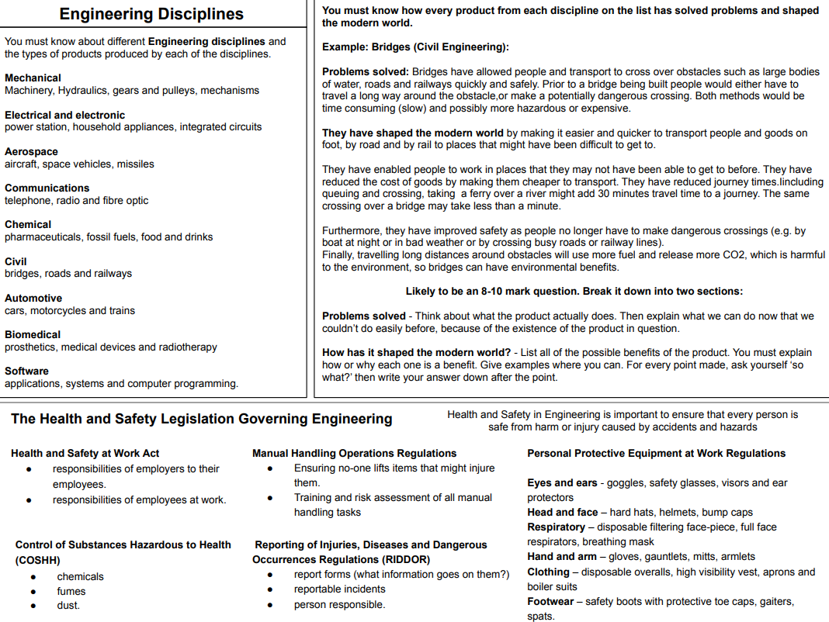
CA 1
E
N
G
I
N
E
E
R
I
N
G
D
I
S
C
I
P
L
I
N
E
S ​

Slide 3
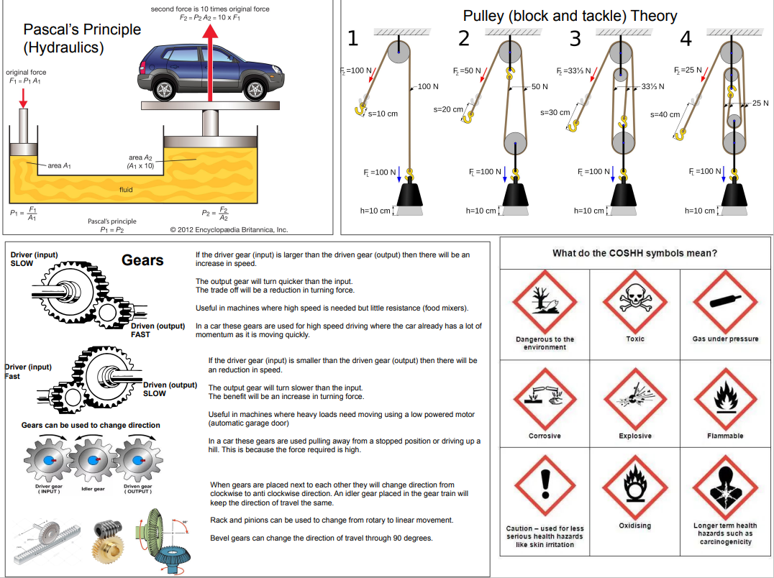
CA 1

Slide 4
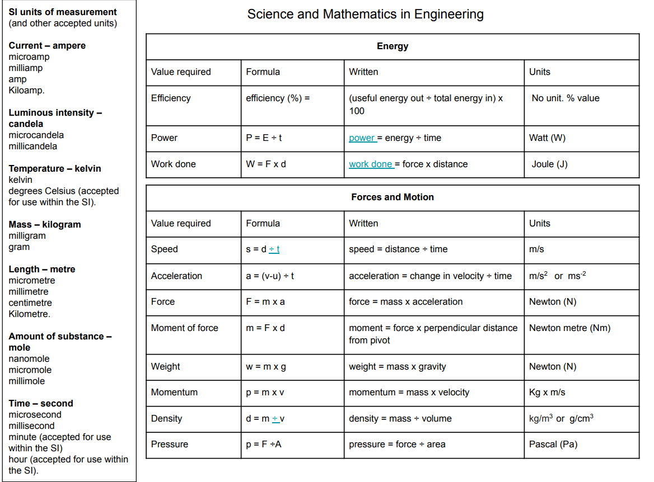
CA 2
S
C
I
E
N
C
E
A
N
D
M
A
T
H
S
​

Slide 5
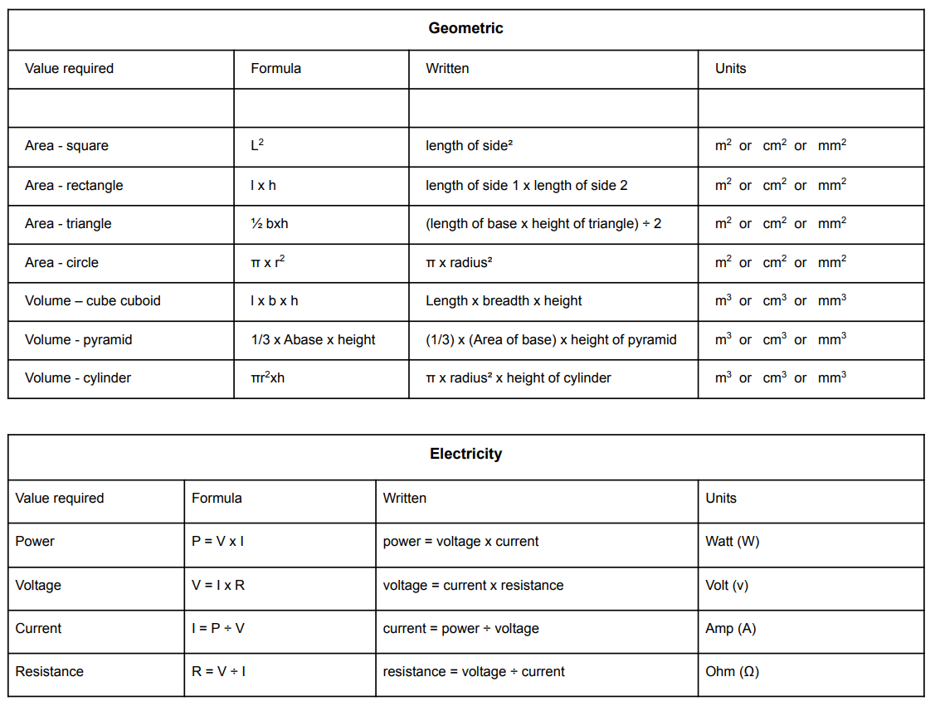
CA 2

Slide 6
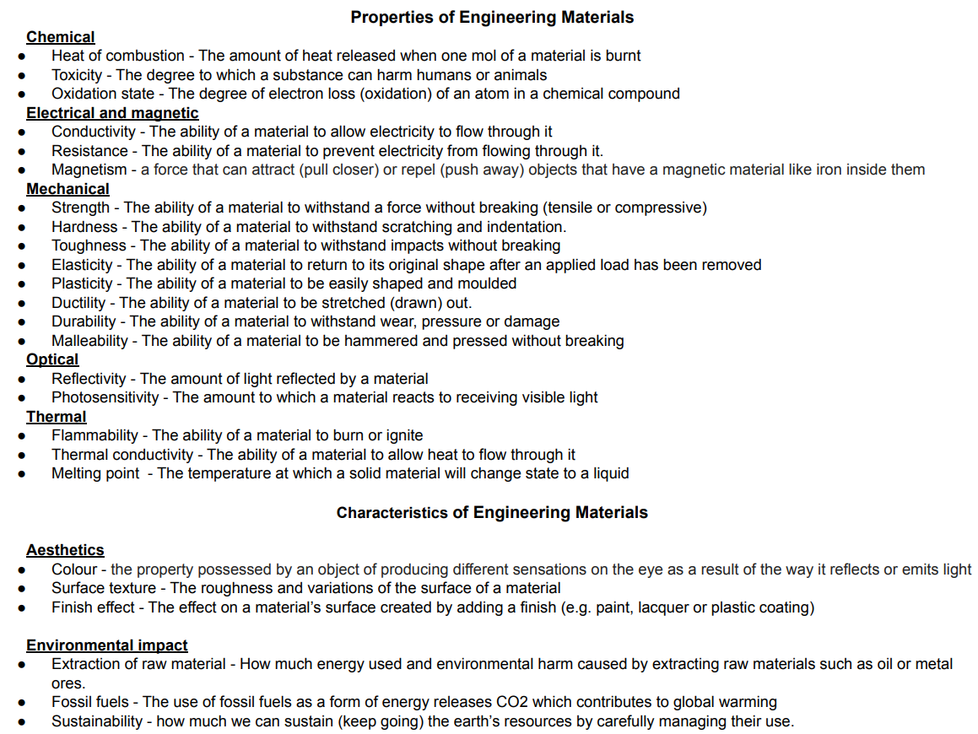
C
A
4
Renewable​ | Advantages​ | Disadvantages​
Wind​ | No fuel needed, no waste or greenhouse gases, can be used in remote areas or offshore to minimise impact.​ | Unreliable, unsightly effect on​ the landscape, can harm birds.​
Solar​ | Low cost after initial outlay, no pollutants or waste, used on small or large scale in remote areas.​ | Expensive initial cost, unreliable, storage system needed.​
Tidal​ | Low cost after initial outlay, no pollutants or waste, predictable.​ | Expensive initial cost, can damage habitats.​
Biomass and biofuel​ | Readily available fuel, can use waste materials, low-cost process.​ | Air pollutants.​
M
A
T
E
R
I
A
L
S

Slide 7
Extraction of raw materials
Timber: Forestry | Cutting down trees causes huge areas of forest disappear. Hardwoods are particularly slow growing and cannot be easily replaced in a lifetime. If forests are destroyed through logging or burning, carbon dioxide (a climate-changing greenhouse gas) is released into the atmosphere. Deforestation also impacts water cycles since trees absorb water through the roots. A lack of trees can cause flooding or areas of extreme dryness. Deforestation also reduces wildlife habitats and biodiversity.
Forest Stewardship Council | FSC forests are managed with consideration for people, wildlife and the environment. Logo is found on wooden and paper products. To make sure more trees are replanted than are cut down so we don’t run out. Shows that… As trees are chopped down, they are replaced. Parts of the forest are untouched to protect animals and plants. Once a section of the forest has been cut down, it is left for 20 years so the trees can re-grow. Local workers run the forest, get a fair wage and safe conditions.
Metals: Mining and drilling | The environmental impact of mining and drilling includes loss of habitat for wildlife caused by the clearance of land, noise, and light pollution. Water run off can also create ponds of concentrated chemicals and pollute water and soils.
Polymer: Oil extraction | Synthetic plastics dominate the plastic processing industry because they are easy to process. The shortage of oil reserves worldwide has led to the adoption of bioplastics extracted from animal wastage and waste biomass. Raw materials from crude oil, natural gas, and sometimes coal need to be extracted for the polymerisation process. Drilling for oil, both on land and at sea, is disruptive to the environment and can destroy natural habitats. Additionally, oil spills have a devastating effect on the environment: they ruin habitats, destroy food sources, and poison living organisms
Gas: Fracking | Fracking is the process of extracting gas from shale. It involves drilling down into the earth and forcing water, sand and chemicals into the rock to release the gas. It can cause mini earth quakes. It could damage the environment. The chemicals used may contaminate drinking water. There could be enough gas in the UK alone to last for decades.
​Life-cycle assessment stage | Plastic | Metal
Material extraction​ | Plastic is extracted using oil rigs, a lot of energy is needed. Animal habitats can be destroyed and potential oil spills ​ | Metal is mined. This create sink holes, can damage water suppls ​
​Manufacturing and packaging ​ | ​Processed, then moulded. Each stage uses energy. Packaged in cardboard. ​ Formed at 160°C (Polypropylene). ​ | ​Processed, then formed. ​ Each stage uses energy. Packaged in cardboard and or plastic. Formed at 1400°C. ​
​Product use and reuse ​ | ​Energy and chemicals used to wash and reuse product Strong so reusable ​ Life expectancy a couple of years. ​ | ​Energy and chemicals used to wash and reuse product. ​ Strong and durable so reusable. ​ Life expectancy 5-10 years. ​
​End of life disposal ​ | ​Recyclable – Requires energy. Not biodegradable ​ Take up space in landfill unless recycled. ​ | ​Recyclable – Requires high amount of energy because of its high melting point. Not biodegradable ​ Take up space in landfill unless recycled. ​
C
A
4
Carbon Footprint- A carbon footprint is the amount of carbon dioxide and other greenhouse gases released into the atmosphere due to the activities of humans. A carbon footprint can be based on the activities of an individual, business, or country.
Direct emissions- are created by individuals and companies and their influence on the environment such as fossil-fuel combustion in manufacturing, heating, and transportation; these emissions are controllable.
Indirect emissions- are emissions that are consequences of the activities of individuals or companies, but occur at sources owned or controlled by another entity, such as the carbon produced by the country in which a person lives and emissions required to produce the electricity associated with goods and services consumed.
Carbon footprint offsetting- consists of neutralising the carbon footprint, or amount of CO2 emissions emitted by an individual, company, organisation, product or service.
The 6R's​
Refuse ​ | Don’t accept a product at all if you don’t need it or if its environmentally or socially unsustainable, do not use materials if it is not environmentally friendly ​
Rethink​ | Change your views on current lifestyles and the way we design and make ​
Reduce ​ | Minimise the amount of materials and energy used during the whole of a products life cycle ​
Reuse​ | Take an existing products that’s become waste and use the material or parts for another purpose, without processing it​
Repair​ | When a product breaks down or doesn’t function properly, fix it​
Recycle ​ | Take an existing product that has become waste and re-process the material for use in a new product ​

Slide 8
Thermosetting - Once heated and moulded, thermoset plastics cannot be reheated and remoulded.
^{Names} | ^{Properties} | ^{Uses}
^{Urea formaldehyde (UF)} | Stiff, hard strong, brittle, good electrical insulator. | Electrical fittings, handles and control knobs, adhesives.
^{Epoxy resin (ER)} | Good electrical insulator, hard, brittle unless reinforced, chemical resistant. | Casting and encapsulation, adhesives, bonding of other materials.
^{Polyester resin (PR)} | Stiff, hard, brittle unless laminated, good electrical insulator, chemical resistant. | Casting and encapsulation, bonding of other materials.
Ferrous Alloys- Contain iron. Almost all are magnetic. Little resistance to corrosion and prone to rust. Good electrical and thermal conductivity/ conductor
Name | Composition | Properties | Uses
Mild steel | Carbon 0.1 - 0.3% Iron. 99.9 - 99.7% | Tough. High tensile strength Good electrical and thermal conductivity. Rusts very easily. | Most common metal used in school workshops. Used in a lot of products.
Cast iron | Carbon 2 - 6% Iron. 98 - 94% | Strong but brittle. High compressive strength. | Castings, utility access covers, engines, pans.
Stainless steel | Iron, nickel and chromium | Tough. Resistant to rust and stains. | Cutlery, medical instruments.
CA 4
Thermoplastic- These plastics can be re-heated and re-shaped in various ways.
^{Names} | ^{Properties} | ^{Uses}
^{Acrylic (Perspex or PMMA)} | Hard, rigid, good surface finish, liable to crack, do not bend. | Display signs, clock faces, fake finger nails, car headlights.
^{Polypropylene (PP)} | Very strong, scratch resistant, lightweight, expensive. | Chair seats, mobile phones, toys.
^{High-impact polystyrene (HIPS)} | Clear, rigid, brittle and moderately strong. | Buckets, bowls, appliances components
Non- Ferrous Metals- Do not contain iron. Are not magnetic. Usually more resistant to corrosion.
Name | Colour | Properties | Uses
Aluminium | Light grey | Ductile, soft, malleable. Very light. Good conductor of heat. | Window frames, aircraft, kitchen ware, bike frames.
Copper | Reddish brown | Ductile, can be beaten into shape, can be polished. Conducts electricity and heat. | Electrical wiring, tubing, kettles, bowls, pipes.
Lead | Bluish grey | Soft, heavy, ductile. Good conductor of electricity | Batteries, roofing materials.
Elastomer- Elastomers have the ability to deform and then return to their original shape almost instantly.
^{Names} | ^{Properties} | ^{Uses}
^{Rubber} | Tough, water repellent, chemical and abrasion resistant. | ^{Footwear, tyres, cookware.}
^{Neoprene} | Temperature insulator, chemical resistant, high tensile strength. | ^{Wetsuits, hoses, orthopaedics.}
^{Silicone} | Elastic, thermal insulator, water repellent. | Sealants, adhesives, lubricant.
Non- Ferrous Alloys - Mixtures either of different metals or of a metal and small quantities of other substances. Require a protective finish.
Name | Composition | Properties | Uses
Bronze | 88 % copper and 12% tin. | Brittle, highly ductile, casts well. Corrosion-resistant | Sculpture, musical instruments, medals, and industrial application.
Brass | 65% copper and 35% zinc | Hard, ductile, casts well, conduces heat. | Parts for electrical fittings, ornaments.
Silver solder | Mainly silver but alloyed with copper. | Ductile, malleable, solders, resists corrosion. | Jewellery, solder, ornaments.
Solder | 60% tin, 39% lead, and 1% other alloys. | Melting range in 270–350°C, good electrical conductivity, good mechanical properties. | Used for soldering. Especially useful in electronics and plumbing.
Manufactured Boards- Manufacture boards are timber sheets produced by gluing wood layers or wood fibres together. Manufactured boards are often made use of waste wood materials. They are not expensive so are often used instead of real woods
Names​ | Properties​ | Uses​
Chipboard​ | Made from compressed wood chips. Strength varies with density. Absorbent to water. Strong and easy to work with.​ | Floorboards, veneered worktops, and self-assembly furniture​
Medium-density fibreboard (MDF)​ | Higher density than chipboard. Strong and cheap.​ | Flat-pack furniture and kitchen furniture.​
​ Plywood​ | Layers of wood bonded together with grains at right angles. Very strong and durable. Can be turned into curved shapes.​ | Flooring and furniture.​ ​

Slide 9
Softwood-Softwoods come from coniferous trees which have needles instead of leaves. They do not lose their leaves in winter. They are ever green.
Names​ | Properties​ | Colours​ | Uses​
​ Pine​ | A straight-grained softwood but knotty. Fairly strong but easy to work with. Cheap and Tough.​ | Light​ | Furniture, constructional work and simple joinery.​
Spruce​ | Small hard knots. Not very durable, tough. ​ | Creamy-white​ | Furniture used in bedrooms and kitchens.​
Cedar​ | Fine even texture. Lightweight, stiff and stable.​ | Pale yellow​ | Furniture, boat building, veneers, and model making.​
Ceramics are made of a variety of materials, but usually silicate minerals as clay, feldspar, quartz, and talc. When heated, these materials become hard and brittle.​
The properties of ceramics include:​
Hardness. Wear-resistance.​ Brittleness.​ Heat resistance (refractory). Thermal and electrical insulation.​ Non-magnetic.​ Chemically stable.
CA 4
Cement | Cement is a material made by heating limestone with clay in a kiln. Cement is mainly used as a binder in concrete, which is a basic material for all types of construction, including housing, roads, schools, hospitals, and dams, as well as for decorative applications.
Bricks | Bricks are produced by mixing clay with water, shaping and forming the bricks, then drying and firing them. Bricks are widespread building materials for walls, chimneys, fireplaces, and more. Bricks are hard, strong under compression, but brittle.
Glass | Glass is a rigid material formed by heating a mix of sand and metallic oxides, which influence the glass properties and its colour. It is brittle and can break if handled carelessly.
Diamond | Diamond is the hardest material available in nature. It has many applications such as industrial abrasives, cutting tools, abrasion-resistant coatings, and, most famously, in jewellery.
Pottery | Pottery is clay that is modelled, dried, and fired, usually with a glaze or finish, into a decorative object. Clay is a natural product that has decomposed from rock within the earth's crust for millions of years. Pottery must be fired to a temperature high enough to mature the clay, meaning that the high temperature hardens the piece to enable it to hold water. Ceramics are heat resistant so they can reach a high temperature without breaking. Clay ceramics are often coated with a glaze (made from glass), which hardens on heating to form a hard, smooth, opaque, and waterproof layer (which makes them non-porous).
Hardwood- come from deciduous or broad-leafed trees. They lose their leaves in the winter. They grow slower than softwoods so they are more expensive.
Names​ | Properties​ | Colours​ | Uses​
​ Beech​ | A straight-grained hardwood with a fine texture. Tough.​ | Light pink. ​ | Furniture, toys, tool handles. ​
​ Oak​ | Durable and strong wood. Open grain. ​ | Light brown. ​ | Furniture, boats, beams used in buildings, veneers. ​
Ash​ | Flexible, tough, shock-resisting density.​ | Pale.​ | Sports equipment, staircases, furniture.​
Sycamore​ | Strong, durable. Interlocked grain​ | Pale, sometimes darker reddish brown.​ | Veneer, pallets/crates, flooring.​
Balsa​ | Soft, durable. Straight grain. Easy to work with​ | Pale.​ | Model building, breakable furniture on film sets.​
A composite material combines two or more types of materials. The properties of each material in the composite complement each other and produce a material with improved properties. E.G Stronger material. ​ A composite material takes the form of fibres, sheets or particles in a matrix (glue).​
Fibre-based composites are reinforced with fibres by mixing resin or concrete with fibres of glass or carbon.
Names​ | Components​ | Propeties ​ | Uses​
Glass reinforced plastic (GRP)​ | Glass fibres and resin.​ | Strong and light material​ | Boats, instrument cases.​
Carbon fibre reinforced polymer (CFRP)​ | Carbon fibre and resin.​ | VERY Strong, has the best weight to strength ratio.​ | Formula 1 car bodies, crash helmets, sports equipment.​
Particle-based composites are made with small particles of material by mixing smaller particles of sand with larger particles of cement and aggregate.
Name​ | Components​ | Uses​
Concrete​ | Cement, sand and aggregate.​ | Buildings, street furniture.​
Reinforced concrete​ | Concrete and steel.​ | Construction on a large scale, such as bridges, dams, piers, tall buildings and stadiums.​
Glass fibre reinforced concrete ​ | Glass fibre and concrete.​ | Street furniture, urban features.​
Natural fibre composite are composite materials in which the reinforcing fibres are derived from renewable and carbon dioxide neutral resources such as wood or plants.​
The applications of natural fibres are growing in many sectors such as automobiles, furniture, packing and construction. ​

Slide 10
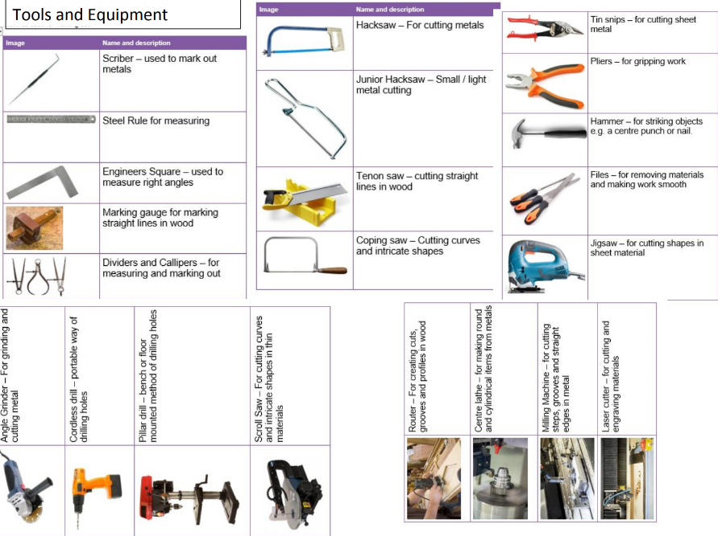
T
O
O
L
S
E
Q
U
I
P
M
E
N
T
​
CA 5
M
A
C
H
I
N
E
S
Drilling
Cordless drills can be used on construction sites because they use a battery, they are portable and light enough to carry around.​
Pillar drills are fixed machines used in workshops, they can apply force, be used on a range of materials, and are good for creating holes in harder materials (such as mild steel). The distance between the drill bit and the bed can be very large, which means there is space for bigger materials.
Bench drills have a smaller distance from the drill bit to the table and are fixed to a bench. This means there is less space for large workpieces.
Bench drills and pillar drills are used to create holes in hard materials, so work-holding devices, such as a G-clamp or machine vice should be used to stop work falling onto the machine operator’s foot.

Slide 11
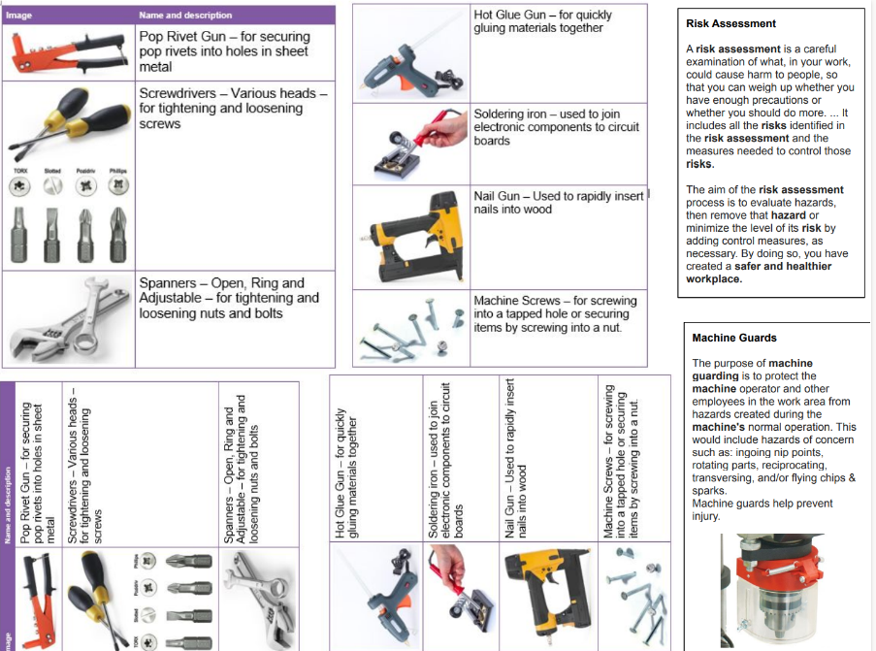
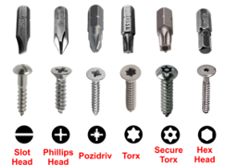
CA 5

Slide 12
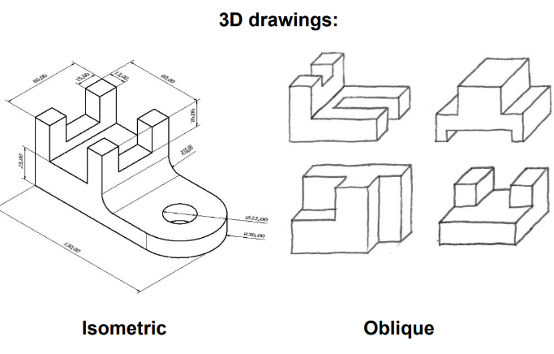
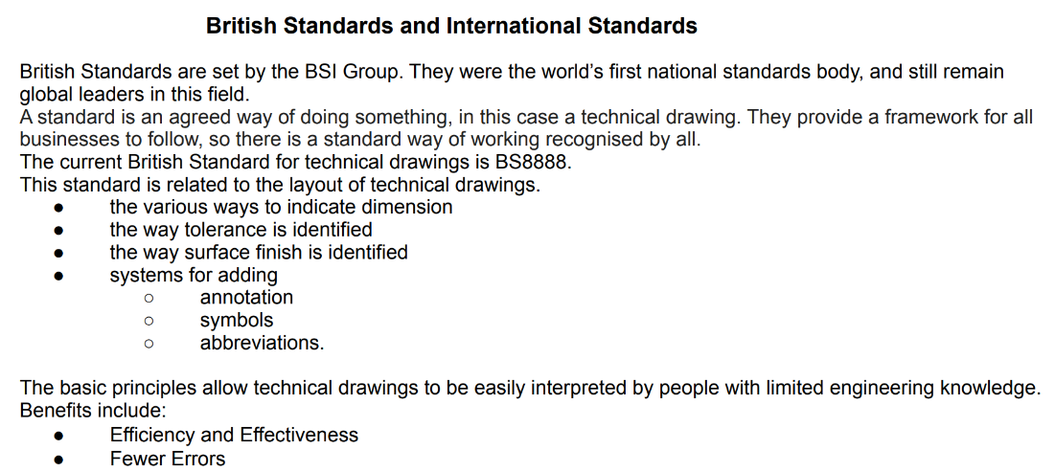
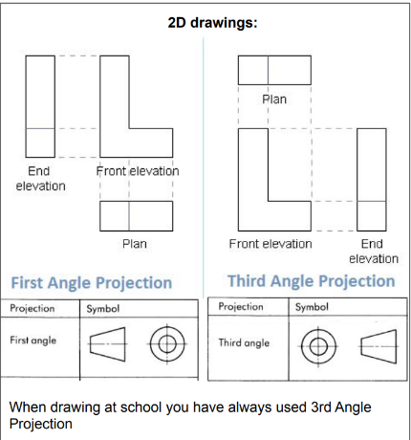
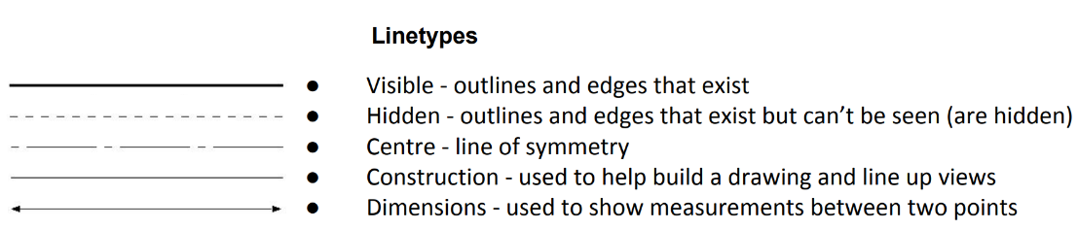
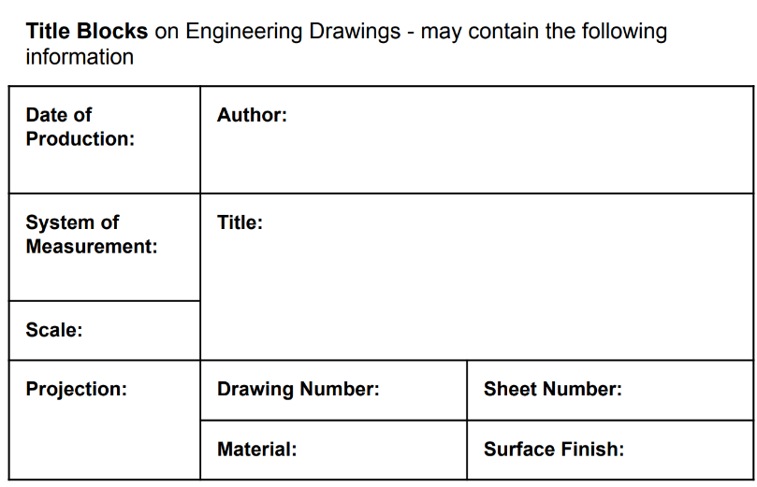
CA 3/ CA6
E
N
G
I
N
E
E
R
I
N
G
​
D​
R​
A​
W​
I​
N​
G​
S​

Slide 13
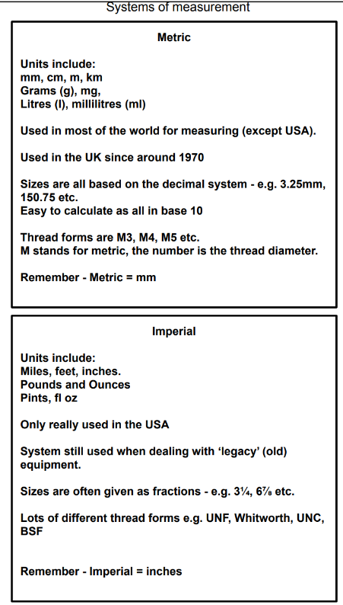
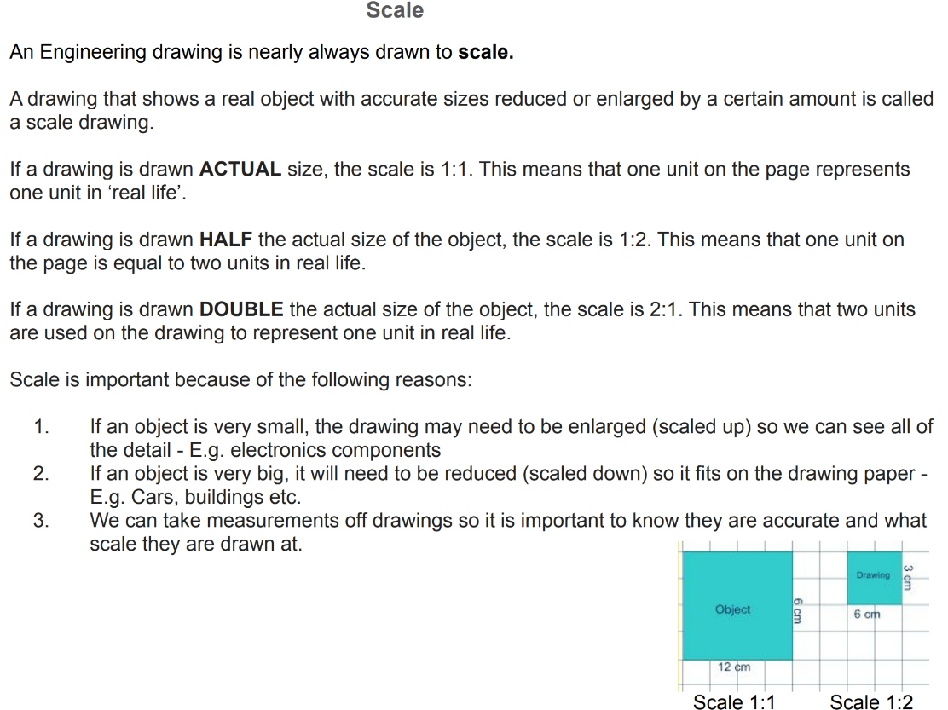
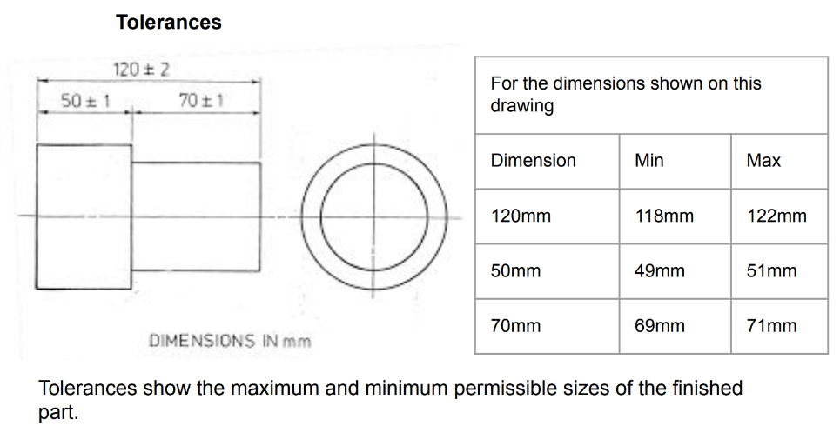
CA 3/ CA6
Annotations
The annotation on your picture or diagram could be used to show key detail, sizes and materials and much more.​
The annotations could help you out as a reference for explaining your design ideas. ​
A design engineer can send their sketches to the client, so they may not always be there. The annotations need to be very clear and explain the design idea.
General: There will be slight variation in size when making components. Creating products to an exact measurement is expensive. Using a smaller tolerance means that production will be cheaper. Products will work and be safe. ​
Specific: A specific or close tolerance is used for specific parts of a design where the size may be more critical. They are used for safety reasons, so parts fit, so they are accurate, so they function correctly and used for location and fit.
To convert millimetres to inches, divide by 25.4.​
To convert inches to millimetre, multiply by 25.4.

Slide 14
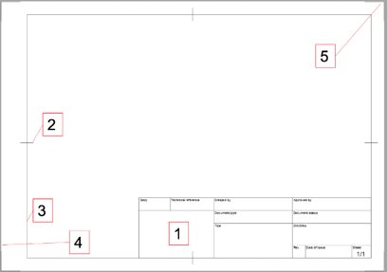
CAD (Computer Aided Design CAD allows users to develop and modify their designs. They can also simulate how different materials will look or perform in a particular design.
Advantages of CAD | Disadvantages of CAD
Ideas can be developed quickly. Drawings can be drawn quickly and changed easily. Designs can be viewed from different angles and with different materials. Ideas can be tested and modified before manufacturing starts. | Set-up is expensive. Users need to be skilled and trained. Technology is always changing, and users need additional training. Some updates and new software are expensive.
Finite element modelling (FEM) | FEM provides a numerical solution to a complex problem, which allows for some level of error. Usually, it is used when a math equation is too complex. FEM can be used, for example, to assess the structural mechanics of different parts of a bridge under different loads and environmental conditions or the deformation of a vehicle from collision.
Finite element analysis (FEA) | Finite element analysis (FEA) is a computerised method for predicting how a product reacts to real-world forces, vibration, heat, fluid flow and other physical effects.
Fluid dynamics | Fluid dynamics is a practical application of finite element modelling software by engineers. Computers are used to perform the calculations required to simulate the free flow of fluids (liquid or gases) and their interaction with surfaces. Fluid dynamics are used to simulate, for example, how airplane wings would perform,
CA 7
C
A
D
E
N
G
I
N
E
E
R
I
N
G
​
D​
R​
A​
W​
I​
N​
G​
S​
Title block.-Title blocks record all important information necessary for engineering drawings.
Centring mark.-centring marks should be provided on all drawings to facilitate their positioning when reproduced.
Frame.-limits the drawing space of the drawing sheet
Edge- a border should be used to demarcate the edge of the drawing region.
Trimming mark.- trimming marks may be added at the edge of the drawing within the border to facilitate trimming of the paper. Trimming marks should be placed at four corners.

Slide 15
Computer Aided Manufacturing (CAM) uses software and computer-controlled machinery to automate a manufacturing process.
One off | This is when only one product is made at a time. One-off products often require high level of skills. One-off products are often highly specialised, custom built . They are normally expensive, because of the amount of skill required and the time taken to make them. Various CAD software programmes draw up virtual 3D models of designs for simulations and testing on screen. No unnecessary manufacture is needed, and expenses are reduced.
Batch | This is when small quantities are made, from a few hundreds to a few thousands, depending on the type of product. Batch production normally uses machine tools, and costs less to make products than with one-off manufacturing, because relatively small volumes are produced. Batch production often has flexible systems and responds to demand from consumer quickly. Batch production uses some industrial methods and makes good use of CAD/CAM because of the relatively fast and repetitive process.
Mass | This is usually carried out on an assembly line by machines and robots. Machinery and automated systems are expensive. The cost of setting up a production line is very high, so large quantities of a product need to be produced to recuperate the initial investment. CAD engineering programmes can be used to produce detailed manufacturing diagrams to be used by equipment on the production lines. CAM equipment has high tolerance levels and is extremely accurate and reliable.
3D printing- 3D printing is the creation of three-dimensional solid objects from a digital file. The process uses additive processes and creates an object by layering layers of material until the object is created.
Advantages | Disadvantages
Different industries now incorporate 3D printing into their processes and take advantage of the technology's capabilities. 3D printing gives the ability to print complex shapes and interlocking parts and to design and produce differently shaped objects without the need for specialised tools. 3D printing provides companies with a greater degree of flexibility in production and helps to reduce production time, waste, errors, and costs. Designs can also be verified through creating a 3D prototype before going ahead with production. | 3D printing has several disadvantages. The major downsides of 3D printing lie in the areas of cost, energy requirement, scale, speed, and accuracy of the operations. 3D printing can also be used for counterfeiting, illegal activities, and the production of dangerous weapons, as there is no regulation or control for purchasing 3D printers. 3D printing is also a disruptive technology that makes several jobs (especially manufacturing jobs) obsolete.
CA 7
CNC- (Computer numerical control) is a computer code that control machine tools. It is commonly used in manufacturing for machining metal and plastic parts.
Laser cutting | Laser cutters work with a computer code (G-code) that starts as a line drawing of a part to be cut, this is converted into a series of co-ordinates, the arm of the laser cutter moves as if the co-ordinates are being drawn onto the bed. Laser cutters can be used to cut wood, polymers, card, paper, and metals, including mild steel, stainless steel, or aluminium. Laser cutters are often used for one-off or batch production because the process is too slow for mass production.
Router | The CNC routing process uses a computer to control the movement of a cutter, allowing for precise, complex shapes in materials like composites and rigid polymers. Routing can be used to produce items such as door carvings, interior and exterior decorations, wood panels, sign boards, wooden frames, mouldings, and musical instruments.
Lathe | Computer numerical control (CNC) turning is a subtractive machining process where a cutting tool is placed against a spinning piece to take material off. This is usually done with a CNC lathe or turning centre which cuts the material including wood, metal, and plastic.

Slide 16
Hazard​
Something that has the ability to harm you or other people​
Risk​
The likelihood that a particular hazard will actually cause harm and how serious that harm would be ​
Control measure ​
A precaution that is put in place to minimise or eliminate risk
Hazard​ | Risk​ | Rating (L,M,H) ​ Likelihood of happening ​ Consequences ​ | Additional Action Required (Action by whom and completion data)​
CA 8
P
R
O
D
U
C
T
I
O
N
​
Risk assessments include:
Include the risk​
Rate its severity (L,M, H) Likelihood of happening (L, M, H) and Consequences​
Additional Action Required (Action by whom and completion data)
Risk Ratings:
Low- Little of no impact to a person or the company
Medium- An activity that has a risk that could cause an impact but not a serious one
High- Could cause life changing damage to a person or cause reputational damage to the company
P
L
A
N
N
I
N
G
Why do we complete risk assessments? | Before starting any activity, a risk assessment should be taken. Risk assessments are performed to bring dangers to attention so that we can limit the risk of accidents happening.
Why are risk assessments important? | Meet legal requirements Prioritize hazards and control measures Prevent injuries or illnesses Decide if existing control measures are working correctly and if anything, else should be put in place Identifying who is at risk
When should risk assessments be completed? | New risk assessments should be: Before new processes or activates are introduced Before changes to certain activities New equipment
Emergency Cut Off | The emergency push button is to stop the machinery quickly when there is a risk of injury or the workflow requires stopping. If a employee get into difficulties on a machine, or they see someone else having problems, only then should the emergency stop button be pushed. Theses can also be located around the factory and workshops.
Isolation buttons | There will be a number of isolation buttons in a factory or in your school workshop. They can be located on machines or on the wall. These should be sign posted. They are red on a yellow background. Machines should be isolated and be able to be turned on by undoing the padlock and key. This prevents accidents. Circuits can be isolated when completing electrical work, this is for safety and stops the flow of electricity to a certain point. This will mean no one will be electrocuted.
PPE | PPE Act- This regulation was set up in 1992 under the health and safety act. These regulations place a duty on every employer to ensure that suitable personal protective equipment is provided to employers who may be exposed to a risk to their health and safety while at work.
Guards | Guards on machines can be adjusted into different positions. They can also be used to prevent saw dust or swaf. With modern pillar drills, if the front guard is not locked into position then the machine will not work. This is a safety feature.
Safety zones | A safety zone can either be painted or taped onto the floor. The zone exists when the machine is being used and it means that no one else should not entre the area. In factories the safe zone can show where people can walk when machinery or vehicles are moving around the warehouse. They can label one way traffic or speed limits.
Extraction and ventilation | Workshop extraction systems are very important for creating a pollution-free environment that is clean, safe and healthy. Extractors filter out particles in the air. This prevents people from breathing in toxic materials that could lung problems, such as breathing problems and cancer. Examples include extraction of sawdust off disc sanders, toxic fumes from spray painting and toxic fumes off laser cutting. Extraction units should be tested every 14 months under LEV testing to ensure they are safe. (Local exhaust Ventilation)
Consequences of failing to carry out risk assessments
Increased risk of accidents
Heath and Safety investigations
Enforcement action
Emotional trauma
Project delays
Financial consequences
Losing customers

Slide 17
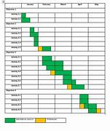
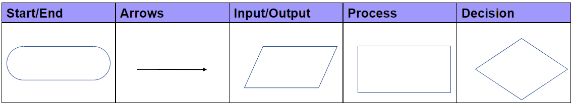
Flow charts
CA 8
Gantt Charts
Gantt charts have the task on the vertical axis and the time frame on the horizontal axis. ​ The horizontal time frame, could be months, weeks, days or in a school project a lesson. ​Boxes are then shaded to show how long the task takes.
An oval shape to represent the start or the end of the process/system. It should contain the word 'Start' or 'End' | The arrow is a line that connects each shape together. It shows the relationship between the shapes | A parallelogram is used to represent the input/output. This represents information entering the system or product. | A rectangle represents a process or a step. | A diamond indicates a decision. This will often have multiple arrows from it. Lines could represent different decisions emerging
Production plan
A production plan is a document that sets out the crucial information about each of the different stages of production. ​ This helps to ensure that the given product along with its components can be made to the same standards. Your production plan needs to show how a product is made. A person should be able to understand and follow your production plan. An engineering plan should be accompanied with an engineering drawing.
Outsourcing
Some companies may not have all the skills or equipment required for specialist tasks . Commissioning another company to do this work is known as outsourcing.
Stage​ | Operations/​ process​ | Materials​ | Tools/​ Equipment​ | Health and Safety ​ | Action​ | Quality Control ​
​ | ​ | ​ | ​ | ​ | ​ | ​
Supply Chain
A supply chain is a networked system of organisations, activities, information, and resources that are designed to source, produce, and transport goods from their point of origin to their destination.
In a supply chain materials and components can be ordered and delivered.
If the supply chain breaks down or it cannot provide the materials or deliver them on time, then the manufacturing will stop.
Considering a good supply chain
Manufacturers should consider the supply chain when developing a new engineering product or component to ensure
They can meet demand (how much the company need)
The materials and components are available
They can work out costs to make the product
They have the correct delivery times and dates, to meet their deadlines
Benefits of timescales and time plans
Increased productivity- When you have a plan, you are able to work more efficiently and get more done in less time as you are more focused as you have goals to achieve. ​
Improved job satisfaction- When you are able to complete tasks, you will feel a sense of satisfaction ​
Less stress- When you have a time plan, you will be less likely to feel overwhelmed or stressed. This is because you will know what needs to be done and when​​

Slide 18
Failing to clean materials
Metal stock usually comes covered in grease to reduce oxidisation and corrosion. Grease can make the material slippery and difficult to handle, it can also make it hard to mark out accurately.
When ferrous metals are stored in cold, damp warehouses or workshops, they can be prone to corrosion over time, iron oxide can form as dark orange layers or a fine powder on the surface of steel.
Marking out can be inaccurate if a material’s surface is uneven and unclean.
Casting
Die casting uses dies made from tool steel, they take a long time and a lot of skill to produce but are useful when making tens of thousands of products or more.​
Investment casting requires a wax pattern made by a combination of machine and hand moulding. They are coated in a ceramic shell, then the wax is melted away and a shell with many cavities is formed. Batches of identical parts are possible.​
Sand casting is best for smaller quantities of products, as packing sand around a pattern is time consuming.
CA 9
S
K
I
L
L
S
A
P
P
L
I
E
D
P
R
O
C
E
S
S
I
N
G
​
Safe use of solvents
Solvents are dangerous chemicals. Engineers need to be aware of the risks and control measures when using them. ​
Solvents are:​
Flammable – So should be stored in a heatproof cabinet, away from direct sunlight and naked flames.​
Irritants – So engineers should ensure that their skin is covered with gloves and overalls.​
Harmful – So should not enter eyes or mouth, be consumed or breathed into the lungs. They should be clearly labelled as they can have the same appearance as water.
Joining of Materials
Bolting-
Nuts and bolts are usually found holding together more than one piece of material. Bolts can be removed to allow maintenance of parts to take place, but they can also work loose and fall off unexpectedly.
Riveting-
Snap rivets have a tail that can be pulled using a rivet gun. This gun squeezes the rivet head against the material and automatically snaps off the tail.
Cold rivets are compressed using force, using either an electric or hydraulic rivet gun.
Hot rivets, often seen in bridge construction, are large so need to be heated before being formed.
Adhesives-
Polyvinyl acetate (PVA) can be used on softwood, hardwood, and manufactured boards.
Contact adhesive can join dissimilar materials and needs to be applied to both surfaces and air dried for ten minutes before joining.
Epoxy resin can join lots of different materials but can be difficult to work with.
Soldering can be summarised as:​
Soldering uses molten metal to join gaps between copper pipes.​
Soldering uses melted metal to join pieces of metal.​
Joining electrical components with melted metal.​
A joining process that turns metal from solid, to molten and back to solid.
Soft soldering - PCBs (printed circuit boards) use soldering so that the joint will conduct electricity around the circuit. The temperature of the process must be low, so that sensitive components do not get damaged.
Hard soldering (brazing) - Copper pipes require soldering as the process allows a small amount of molten metal to flow around a joint, sealing the gaps. This is very important for gas pipes and keeping homeowners safe from gas leaks.
Preparing materials for marking out​
De-burring stock with a file to remove sharp edges should take place before marking out, to reduce the risk of injury to the engineer.
Metals cannot be marked accurately with a pen or pencil, because the lines wipe away. To mark out accurately, engineer’s blue can be used to dye the surface, this makes marking out “scratches” easier to see.
Bending Materials
A press brake forces sheet metal into a V shaped groove, to create a fold.
Pressing can create very complex shapes at the same time as stamping (cutting) out the final shape.
Tubes must be formed around a jig, or the tube collapses and the strength is lost.
Blacksmiths use a forge, anvils, hammers and heat; the force bends into mild steel.
Finishing is the term used to describe preparing and applying a surface coating to a material.​
Finishes are applied for several reasons, including:​
Improving the appearance.​
Protecting from corrosion.​
Improving wear resistance.​
Reducing friction.​
Increasing the life span of the product.​
Preparation and use of saws
Before using a saw, engineers should consider the following:
The condition of the saw: missing teeth and damaged guards.
The shape of the cut (straight, curved, or intricate) shown on the engineering drawing.
The material that can be cut (wood, metal, plastic).
The thickness/density of the material and the force required.
The scale of production (how many cuts/products need to be made).
The location: in a workshop or on a work site.

